Slide 1
CLOUD COMPUTING PROJECT
PRESENTATION

Slide 2

University of Management and Technology (UNIMTECH) Group Project: Collaborative Development of a Financial Calculator Using Git and GitHub
Group: A

Slide 3
# Step-by-Step Documentation for the Payment Calculation Program

Slide 4
1. Overview
This Python program allows users to calculate:
Loan Payment
Compound Interest
Savings Growth
The user is prompted to choose the type of calculation, after which the corresponding function is executed.

Slide 5
2. Program Flow
User Input: The program first asks the user to choose a payment type:
" 1. LOANPAYMENT"
" 2. COMPOUNDINTEREST"
"3. SAVINGSGROWTH"
Decision Making: Based on the user’s input, the program calls the respective function:
loan_pay () for loan payments.
compound_interest () for compound interest.
savings_growth () for savings growth.
Computation: The program collects user input, performs calculations, and outputs the result.
Error Handling: If an invalid option is entered, the program prompts the user to select a valid payment type.

Slide 6

3. Function Breakdown
3.1 Loan Payment Calculation (loanCalculation())
Inputs:
Principal amount
Annual interest rate
Loan term in years
Processing:
Converts the annual interest rate to a monthly rate.
Uses the loan payment formula: $\frac{P×r×{\left(1+r\right)}^{n}}{{\left(1+r\right)}^{n}−1}$
Where:
M= Monthly payment
P= Principal loan amount
r= Monthly interest rate (Annual rate / 12 / 100)
n= Total number of months (Years × 12)

Slide 7
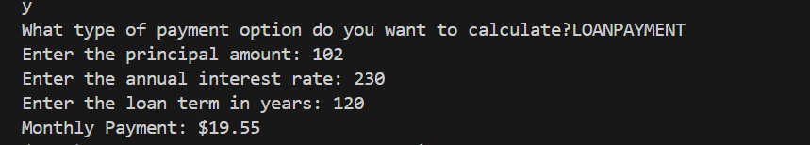
Output:
Displays the calculated monthly payment.
3.2 Compound Interest Calculation (compoundInterestCal())

Slide 8

Inputs:
Principal amount
Annual interest rate
Years invested
Number of times the interest is compounded per year
Processing:
Converts the annual interest rate into a decimal form.
Formula: $A=Px{\left(\begin{aligned}1+\frac{r}{n} \\ \end{aligned}\right)}^{nx^{t}}$
Where:
A= Future value of the investment
P= Principal amount
r= Annual interest rate (in decimal form)
n= Number of times interest is compounded per year
t= Time in years

Slide 9
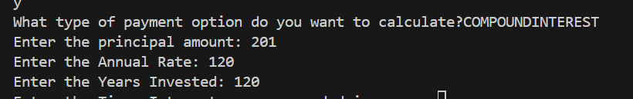
Output:
Displays the future value of the investment.
3.3 Savings Growth Calculation (SavingsGrowth())

Slide 10

Inputs:
Initial savings
Monthly contribution
Annual interest rate
Number of times interest is compounded per year
Number of years
Processing:
Converts annual interest rate to decimal form.
Formula: $FV=P+{\left(1+r\right)}^{t}+\frac{M×\left[{\left(1+1\right)}_{−}^{t}1\right]}{r}$
Where:
FV= Future value of savings
P= Initial savings
M= Monthly contribution
r= Monthly interest rate (Annual rate / 12 / 100)
t= Number of months

Slide 11
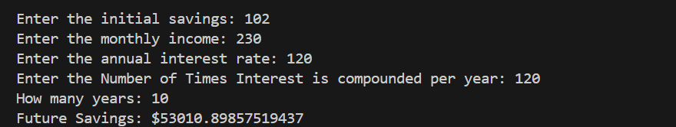
Output:
Displays the future savings amount.

Slide 12
4. Error Handling
If an invalid payment type is entered, the program displays:
Please choose between one of the following payment types:
LOANPAYMENT
COMPOUNDINTEREST
SAVINGSGROWTH
Below is a summery of the flowchart

Slide 13
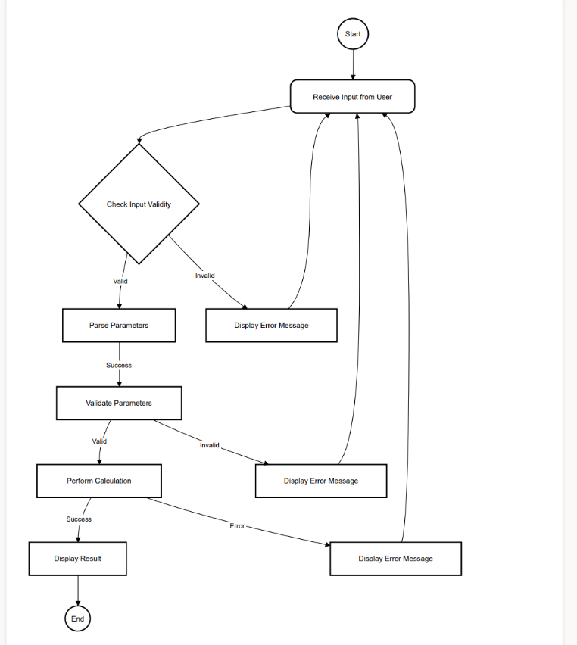

Slide 14
END OF PRESENTATION

